Slide 1


A Perfect song for your Mood
Aaron Luo, Yanyi Wang, Manavbir Sahani, Jaipal Sandhu, Mohammad K.Khan
Notes:
I’m Manny and I’m here with my team mates Aaron, Yanyi, Jaipal & Mohammad.
We’re here to present SongVibes our project that helps you choose songs based on your emotions using EEG brain waves.
Speaker : Manny

Slide 2
Structure of presentation
Motivation & Introduction
Related work
Methods
Results
Discussion
Conclusion
Bibliography
Notes:
Talk about the structure of our talk so everyone can follow how we will cover everything
Speaker : Manny

Slide 3
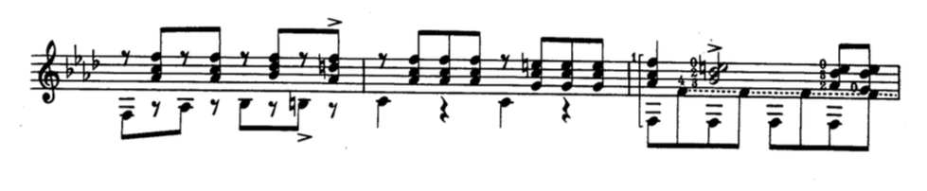



Motivation
Bad Day
JoyVibe’s Recommended Song
Alleviated mood
-> Pleasure is evoked by sad music when someone sad listens to it due to the feelings of being moved and empathy ( Vuoskoski et al. 2017)
Notes:
Answering the question : Why are we doing this
As we were a team passionate about music, we started our journey by reviewing literature on effects of music on one’s emotions. We found that when sad songs actually help people going through sad emotions because they get pleasures from the feelings of empathy in the sad song.
We can conducted multiple diary studies and interviews, and found that a significant number of people listen to music when they are having a bad day to help them cope up with all their stress.
This got us thinking in terms of automating this process and was one of our main motivations for coming up with an an application that could recommend a song based on people’s emotions.
To solve this problem, we created an application that could recommend a song based on people’s emotions.
we are also looking to give those in a locked in a state (LIS) the ability to not only play music but also choose the kind of music they wish to listen to given their current emotional state.
Speaker : Manny

Slide 4

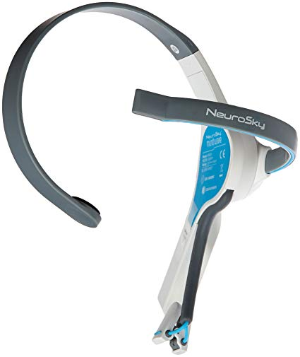
Introduction
-> Use brainwave data to determine user’s current emotions.
-> Based on user’s emotions, choose a song to alleviate their current mood.
Notes:
Answering the question : What are we trying to do
For our project, we used Neurosky headset to collect the user’s brainwave data on a user’s emotions. The device was portable and was very easy to link to other applications which made it very user friendly.
This data was then analyzed using various classification algorithms in groups of positive and negative emotions which was then used to tailor a song recommending to alleviate your current mood.
Speaker : Manny

Slide 5
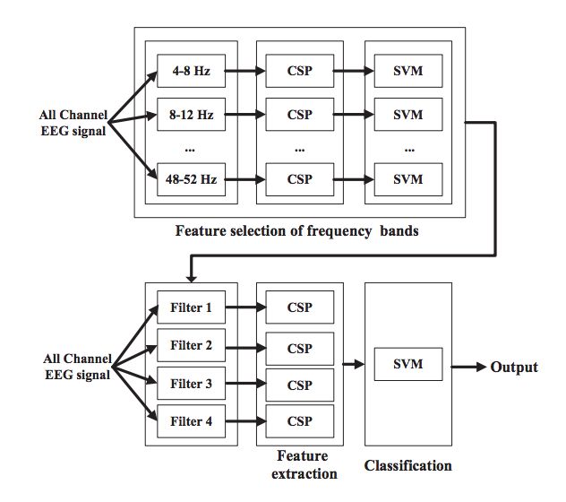
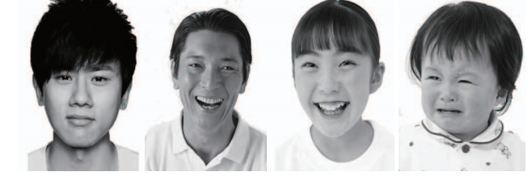
Related Work :
An EEG-Based Brain-Computer Interface for Emotion Recognition
74% Accuracy for happiness vs sadness
Notes:
SHOW HOW THIS PAPER ADDRESSES A PART OF THE PROBLEM WE ARE SOLVING
Explain what has been done previously
Speaker : manny
Related work
During literature review, we found that a paper in the AIEEE journal was able to achieve a 74% accuracy on detecting two basic emotional states (happiness and sadness). This emotional recognition paper approached this problem in three progressive stages: feature selection of frequency band, feature extraction using CSP, classification using SVM.
We wanted to try this problem using our approach, and use it for our application.
First, we employ a filter bank that bandpass filters the EEG signals collected in training phase into multiple bands. Second, spatial filtering is performed on each of these bands using the CSP algorithm. Next, a 10-fold cross-validation using SVM is applied to the CSP features of each frequency band.

Slide 6
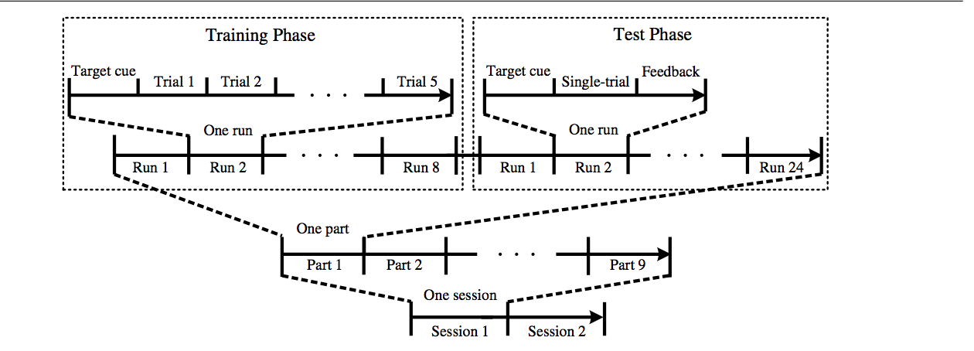
Related Work :
A novel BCI based on ERP components sensitive to configural processing of human faces.
Notes:
Speaker : khawar
Explain what has been done previously
Some of the related work to our project is the project published by Neural Engineering( HOW), the project was based on training data by using human faces features to detect the target. The conventional BCI with visual stimuli of intensification has been widely studied and developed, and generally can achieve good target detection performance with the average of several trials. the accurate target detection with single trial for the P300-based BCI is still a challenging problem, since the P300 is relatively weak and usually occurs amid some ongoing background brain activities, such as spontaneous EEG and other noises . Thus, the development of a new paradigm with more effective visual stimuli.

Slide 7
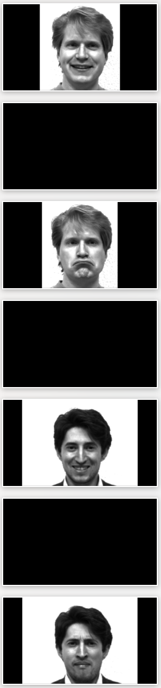
Methods :
Participants
10 UCSD students
5 Males and 5 females
Stimuli
100 pairs of happy & sad face pictures (total 200 pictures)
Duration
Potential confound
EEG Recording through
NeuroSky
NeuroPy
Notes:
Speaker : Yuie
We collected data from 10 subjects, 5 male and 5 female. Subjects are all UCSD undergraduate students (five females; age range---- years, mean years, five males) participated in the experiment after giving written informed consent. All subjects are right-handed and reported to have normal vision. No psychological disease or disorder.
Talk about Stimuli
The stimuli we used for gather data is 100 pairs of pictures of human faces with positive and negative emotion. In Total 200 pictures, We separated the 200 pictures for 4 trials, each has 50 pictures (1 min 30 sec) each pair has positive and negative emotion faces of same person to control the variable.
We separate the 200 pictures to 4 trials to reduce fatigue affect .The pictures of faces are found on google or photoed by teammates. But there is one Potential confound: Background of pictures
Talk about EEG recordings. Talk how the recordings happened
We used the neurosky headset to record participants brain wave. The neuoSky headset is connected to a windows computer by bluetooth,And we use neuropy algorithm to read brain wave data,
The sampling rate is 250 HZ, time between each stimuli is 4ms, record for 2 sec(1s for picture, 1 for black page).
Since we used the raw eeg data, gamma has the highest frequency wave, the sampling rate should be at least two times higher than the highest frequency wave which is 100hz. So we choose the 250 hz sampling rate.

Slide 8


Procedure :
Notes:
Speaker Yuie
All the pictures are made black and white using function in python.to reduce the confunding variable ( Mention function name)
Potential Confound : background is not remove due to the limited time span.
Using the trained algorithm to predict positive/negative emotion of new brain wave signal.
Select a song with pos or neg mood
Before the experiment start, we checked the connectivity of neurosky head set and make sure it is collecting data, and it is well connected,
In the Neurosky EEG headset experiment we asked participants to look at the experiment videos we created.,each video is one trial, containing pictures of people’s faces with
pleasant and unpleasant emotions, and they were presented alternately. Each stimu-
lus began and ended with a blank page of 0.5 s, Each picture is presented for 1 second
and each trial has 50 pictures present. The sample video experiment should looks like this.
During the experiment, participants are asked to try not to move their head too much to avoid artifact created noise.
This is the code using NeuroPy algorithm to collect data, how we synchronizing data gathering and the experiment video.

Slide 9
Methods : Classification of our data
Algorithms
PCA
Linear SVM
Radial Basis SVM
LDA
Perceptron
Random Forest
Notes:
Speaker : JP
Regression algorithms employ the features extracted from EEG signals as independent variables to predict user intentions. In contrast, classification algorithms use the features extracted as independent variables to define boundaries between the different targets in feature space.
For a two-target case, both the regression approach and the classification approach require the parameters of a single function to be determined. In a four-target case, assuming that the targets are distributed linearly, the regression approach still requires only a single function. In contrast, the classification approach requires the determination of three functions, one for each of the three boundaries between the four targets. Therefore, the classification approach might be more useful for two-target applications and the regression approach may be preferable for greater numbers of targets, when these targets can be ordered along one or more dimensions. Moreover, the regression approach is better for continuous feedback
We used PCA to initially lower the dimensionality and noise of the dataset.
We then looked at a Linear SVM because our data was labeled and our goal was classification and it more immune to overfitting than a nonlinear SVM
In the case that our data was not linearly separable we took a look at a rbf SVM
We decided to try another dimensionality lowering algorithm in LDA to compare its performance with PCA
Since we had a high dimensional dataset we looked at perceptron due to its low process time and high accuracy, specifically for high complexity datasets.
We used Random Forest to verify the validity of our other tests due its nature highly accurate. And processing time was not a large concern due to the fact that the dataset was relatively small.
SVM is a discriminative classifier formally defined by a separating hyperplane. In other words, given labeled training data (supervised learning), the algorithm outputs an optimal hyperplane which categorizes new examples
SVM is a classifier that, in a similar way to LDA classifiers, constructs a hyperplane or set of hyperplanes, in order to separate the feature vectors into several classes(BCI review paper section 7)
However, in contrast to LDA, SVM selects the hyperplanes that maximize the margins, that is, the distance between the nearest training samples and the hyperplanes [236].
LDA Linear Discriminant Analysis
is a very simple classifier that provides acceptable accuracy without high computation requirements. LDA is very common in the BCI community and is a good choice for designing online BCI systems with a rapid response, but limited computational resources.(BCI review paper section 7)
We used perceptron because it works well with highly complex dataset
The aim of the classification step in a BCI system is recognition of a user’s intentions on the basis of a feature vector that characterizes the brain activity provided by the feature step. Either regression or classification algorithms can be used to achieve this goal, but using classification algorithms is currently the most popular approach [209].

Slide 10
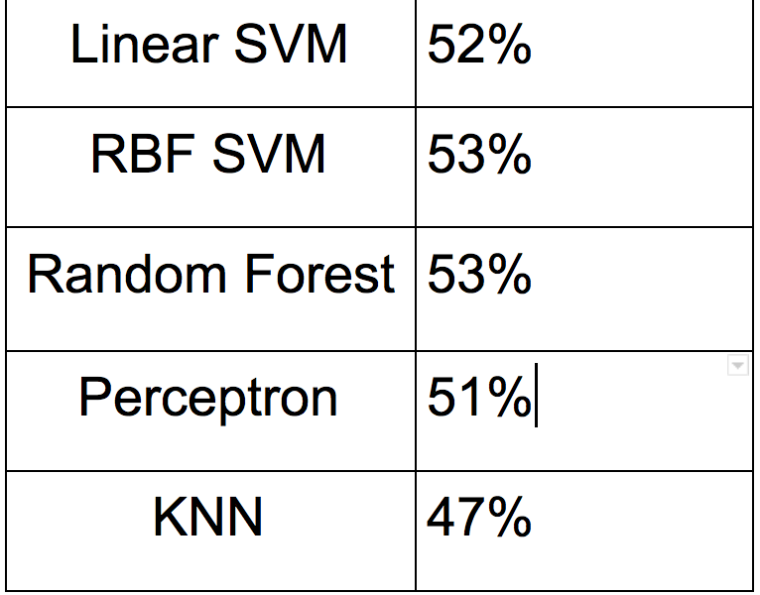
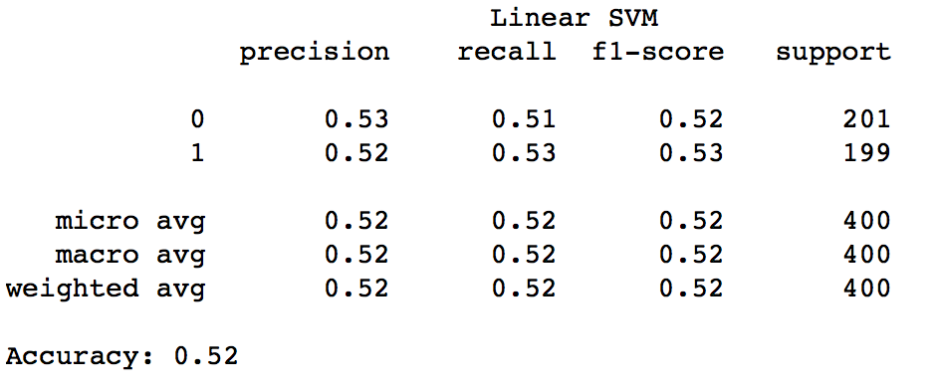
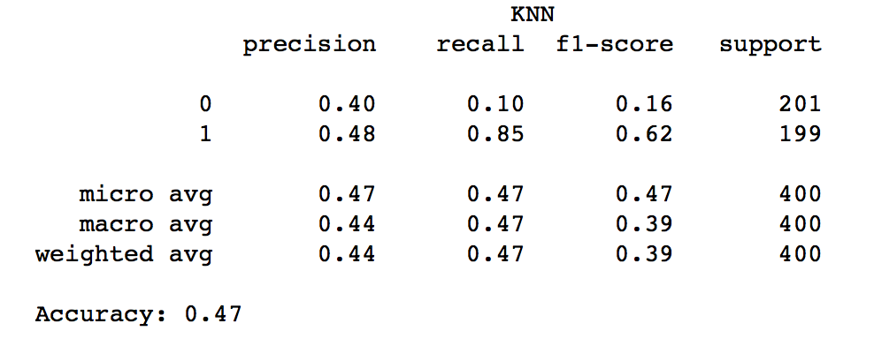
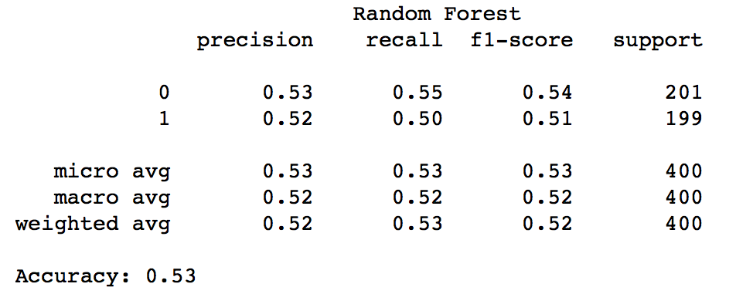
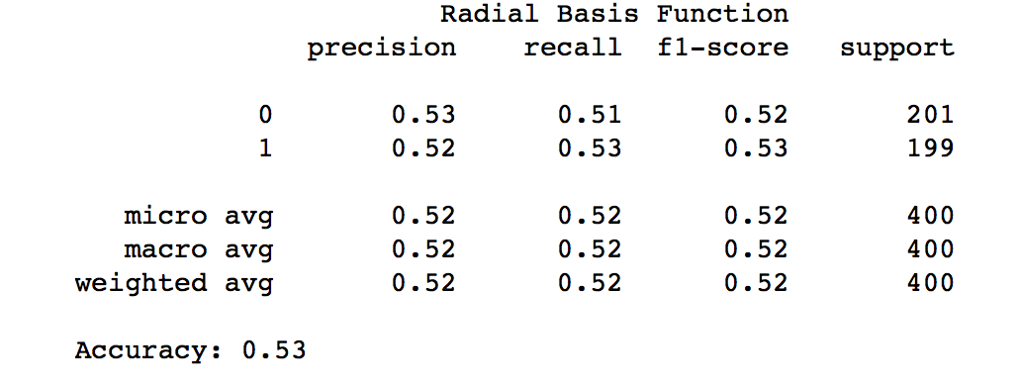
Results :
Notes:
Speaker : Aaron
As seen from the chart above, all of the classifiers we used returned very low accuracy rates, with linear SVM return 52%, RBF Kernel SVM returning 53%, Random Forest returning 53%, Perceptron returning 51% and KNN returning 47%. What was especially surprising was the extremely low accuracy rates of Random Forest and KNN, two algorithms that typically return reliably high accuracy rates, usually at the cost of process time. The precision-recall rate of all of the classification algorithms were also around 50%. This suggests that, because no classifier could accurately assign a label to the data points much better than a coin flip would, the dataset is highly uncorrelated and cannot be used to accurately train an algorithm or predict emotion data.

Slide 11
Discussion
Challenges we faced & Our Solutions:
Problem : Synching video with data gathering
Our Solution : Using threading, simultaneously, run the stimulus & data gathering algorithms Subsequent Problem : Too complicated & deviant from original code
Our Solution : Subtracting process time from sleep time
Problem : Neurosky headset stopped reading values after 40
Our Solution : Test in 4 batches of 25
Notes:
Speaker :Aaron
Problem synching video with data gathering :
There was a small time difference of 0.02 between the stimulus and the data gathering algorithm due to the imprecision of time.sleep. Since we were using 200 stimulants, the difference would eventually become significant, and we would end up collecting data on the wrong stimulus entirely.
Our first solution, involved trying to run the stimulus and the data gathering algorithms in tandem. Since the stimulus and the data gathering functions needed to run at the same time, we used threading, and ran the two threads independently from each other, creating the potential synchronization issues. This method proved to be too complicated for me and was extremely deviant from how the code was originally written, making it very difficult to debug, so I eventually dropped this idea. Our second method was to try to compensate for the time drift by subtracting process time from the sleep time and using generators to compensate for imprecision of the time.sleep function itself.
Another challenge we encountered was in reading from the Neurosky headset using our code. Originally, we were presenting subjects with all 100 pairs of our stimulus at once, but after 40 or so pairs the Neurosky headset stopped reading in values for some undetermined reason. So we decided to test in 4 batches of 25 pairs, which worked ended up working perfectly. This also solved another potential issue of subject fatigue after being presented with so many pictures at once.

Slide 12
Discussion
Our Learnings:
Working with raw EEG data requires alot of time and expertise.
NeuroSky only records data from prefrontal cortex & that alone be used for emotional processing.
Should have used a similar one electron data gathering hardware that gathered data from the temporal lobe, closer to the amygdala.
Notes:
Aaron/ JP
We learned a few things in regards to data gathering in general as well as some things about the NeuroSky headset.
Initially we decided to use raw EEG data, as it was essentially an unfiltered combination of all the signals available to be processed using the NeuroPy algorithm, such as alpha waves, beta waves, theta waves, etc. The goal was to collect all the signal types at the same time through the raw EEG data and then use dimensionality reduction algorithms to find the most relevant frequencies. This proved to be somewhat of a mistake, as the dataset gathered from the raw EEG data was either so noisy or so uncorrelated that it was difficult to impossible to discern which frequencies would be the most relevant to our primary purpose of differentiating between positive and negative emotion brainwaves.
We also learned about the limitations of the NeuroSky dataset. The most obvious one would be the fact that it only collects data from one electron, but what is perhaps more important in this case is the fact that it collects data from the prefrontal cortex, which is not an area primarily concerned with emotional processing. Under the scenario that we had a similar one electron data gathering hardware that gathered data from the temporal lobe, closer to the amygdala, we might have been able to gather data that was more relevant to emotion.

Slide 13
Discussion
What we could do better :
-> Gather data through a different filter.
-> Run trial tests with our stimulus to ensure emotional impact.
-> Make stimulus more interactive
-> Use standard EEG headset
Notes:
Aaron
If we had to do it again, we would probably gather data through a different filter so as to try to find the signal with the highest correlation to emotional processing. This is what we were attempting achieve by gathering raw EEG data, but this did not end up working out, so perhaps it would be better if we gathered them individually.
Another thing we could have done better is running some trial tests with our stimulus to ensure that the pictures actually had any emotional impact on the test subjects. As it stands, we nothing to speak about the effectiveness of the stimulus, although based on the data it is likely it had no meaningful effect.
We could also potentially use a stimulus that has more interactivity than the stimulus we used to make sure that the subject was actually focused on the video and not thinking about something else. This is based on the fact that a few of our subjects reported boredom and lack of focus during stimulus time, so more interactivity could potentially help remedy this.

Slide 14
Conclusion & Future Work
Our dataset was either too noisy or too uncorrelated.
In the future, we could:
Use a standard EEG headset
Use blink to change songs
Read attention data to find response to sound or song stimuli
Notes:
Speaker : Aaron
To conclude, we were not able to achieve much of anything with the data we collected due to the fact that all the data points were seemingly unrelated based on the fact that, even after PCA, none of the classification algorithms we used, including Random Forest and KNN, were able to meaningfully separate the data.
In the future, we could attempt something similar with a standard EEG headset rather than a single electron headset we used in this project. We could also do something potentially less complicated related to music and emotions, such as using blink signals to switch songs or reading attention data to determine the response test subjects have to specific sound or song stimuli.

Slide 15
Bibliography
The Pleasure Evoked by Sad Music Is Mediated by Feelings of Being Moved, Jonna K. Vuoskoski1,2,* and Tuomas Eerola2,3
Link : https://www.ncbi.nlm.nih.gov/pmc/articles/PMC5359245/
Allison, B. (2011). Trends in BCI research. XRDS: Crossroads, The ACM Magazine for Students,18(1), 18. doi:10.1145/2000775.2000784
Zhang, Y., Zhao, Q., Jing, J., Wang, X., & Cichocki, A. (2012). A novel BCI based on ERP components sensitive to configural processing of human faces. Journal of Neural Engineering,9(2), 026018. doi:10.1088/1741-2560/9/2/026018
Link : https://iopscience.iop.org/article/10.1088/1741-2560/9/2/026018/meta
Pan, J., Li, Y., & Wang, J. (2016). An EEG-Based brain-computer interface for emotion recognition. 2016 International Joint Conference on Neural Networks (IJCNN). doi:10.1109/ijcnn.2016.7727453
Link : https://ieeexplore.ieee.org/abstract/document/7727453

